Slide 1
A Better Way to do Benefits

Slide 2
Welcome to ClearBenefits.ca
Web-Based Group Benefits Provider
Proven solutions for small & medium sized businesses (3 – 20+)
Comprehensive range of products and services
Better Choices…
The right solution for your situation
Pooled Program
Experience-Based Program
Group Retirement Program
*Pooled Group Benefits Programs underwritten by Co-operators Life Insurance Company

Slide 3
Why Benefits?
Attract and retain the right staff
Cost effective method to reduce turnover
Incentive for part-time staff to increase to full-time hours
Employees feel valued, resulting in a higher degree of company loyalty

Slide 4
What are Clients Looking For?
Affordable plan
Best opportunity for rate stability and easy to budget for
Coverage attractive to staff
Functions in the background most of the time
Assistance with admin and service issues when they arise

Slide 5
Employer Priorities
85% of employers are 3 – 20 staff – Typical is 7 staff (including the owner)
Quality coverage
Options for almost any budget – comprehensive to entry-level
Rate stability

Slide 6
Price vs. Affordability
Employers are pleased with how affordable our plans can be
Most employers share the cost of a plan 50/50 with their employees
If the employer portion of the cost is 2.5 - 3.5% of payroll, both the employer and the
employees are generally comfortable and feel they are getting good value
Choose a plan that is a good place to start, leaving room to enhance your benefits
program at a future date

Slide 7
Consumer Trends – The New Reality
Consumers continue to embrace benefits as part of their daily lifestyle
Changing how they utilize benefits plans – preventative vs. reactive
Pool claiming patterns remain consistent
Employers are asking for new ways to help retain staff – Group RRSP / TFSA

Slide 8
The New Normal - EHC

Slide 9
What is the Best Solution?

Slide 10
Selecting the Right Structure
There is no one “right” approach for all situations
The type of plan you choose depends on how you answer the following questions:
How important is it for you to be able to reasonably budget for benefits costs?
How much risk you are willing to assume?
Would you prefer to transfer risk to the insurer?
2 main approaches:
Pooled
Experience-Rated

Slide 11
Pooled Programs
Most Popular
Notes:
Lets take a closer look at

Slide 12
Why Pooled Programs?
“True insurance” approach towards benefits
Spread of risk across many clients
Transfer of risk to the pool
Focus on long-term risk-management practices
Effectively eliminates volatility common to most benefits plans
Deliver the rate stability clients expect

Slide 13
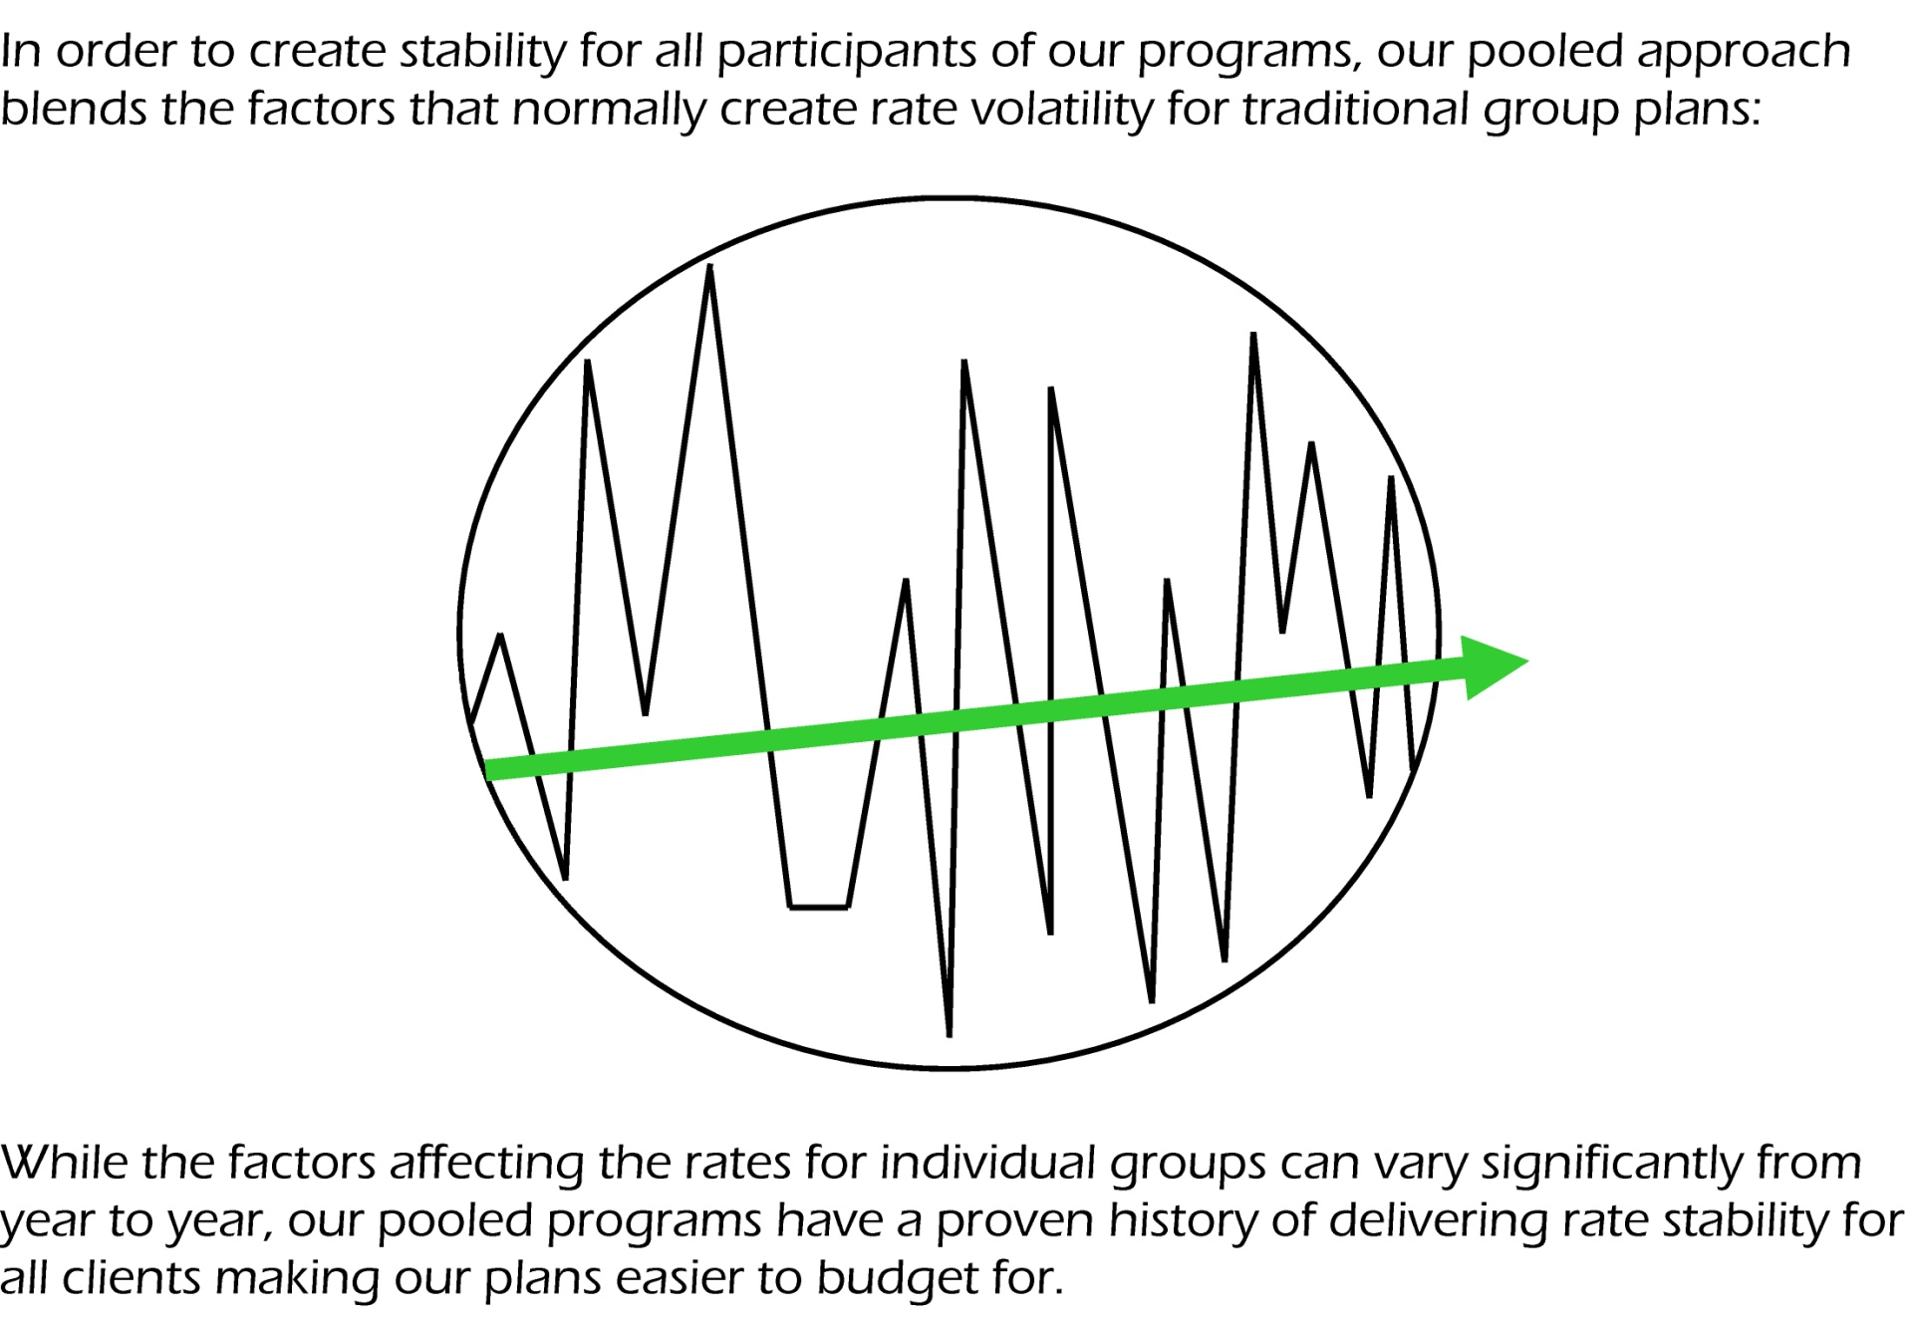
Notes:
This visual is also in the info package and website
lt seems to have the most impact with clients.
It is an accurate representation of what claims look like in the pool

Slide 14
2 Programs
Ideal for groups of 3 – 20+
Designed to meet the needs of this market
Feature pooled rates and claims for Extended Health & Dental
Rates are based on average age, claims, size of the pool etc.
Exclusive from ClearBenefits.ca
Notes:
-
-
-
-
Some customization available
-

Slide 15
Essentials Program
Most Affordable options
Wide selection of benefits
Popular choice across many industries
No medical questions required

Slide 16
Lifestyle Program
Enhanced coverage
Higher limits
Popular choice for any industry
No medical questions required

Slide 17
Advantages
Solutions for almost any situation
Different levels of coverage available per employee class
Large group advantages and expertise for small and medium sized businesses

Slide 18
Other Programs
Notes:
Lets take a closer look at

Slide 19
Service
Local & National Service
ClearBenefits.ca support includes:
Initial plan selection
Structured service plan
Master Application support
Claims support
Administrator support
Cost containment support
Help ensure clients are paying fair and responsibly priced premiums

Slide 20
Quotes
Submit Online:
Email PDF or Excel quote form
Quotes for Pooled Program are typically ready in 1 business day
Quotes for Experience-Rated plans are usually 5 – 7 business days

Slide 21
Questions?
Notes:
If you have questions or a special situation you would like to discuss
Please feel free to contact us
We look forward to working with you

